Slide 1
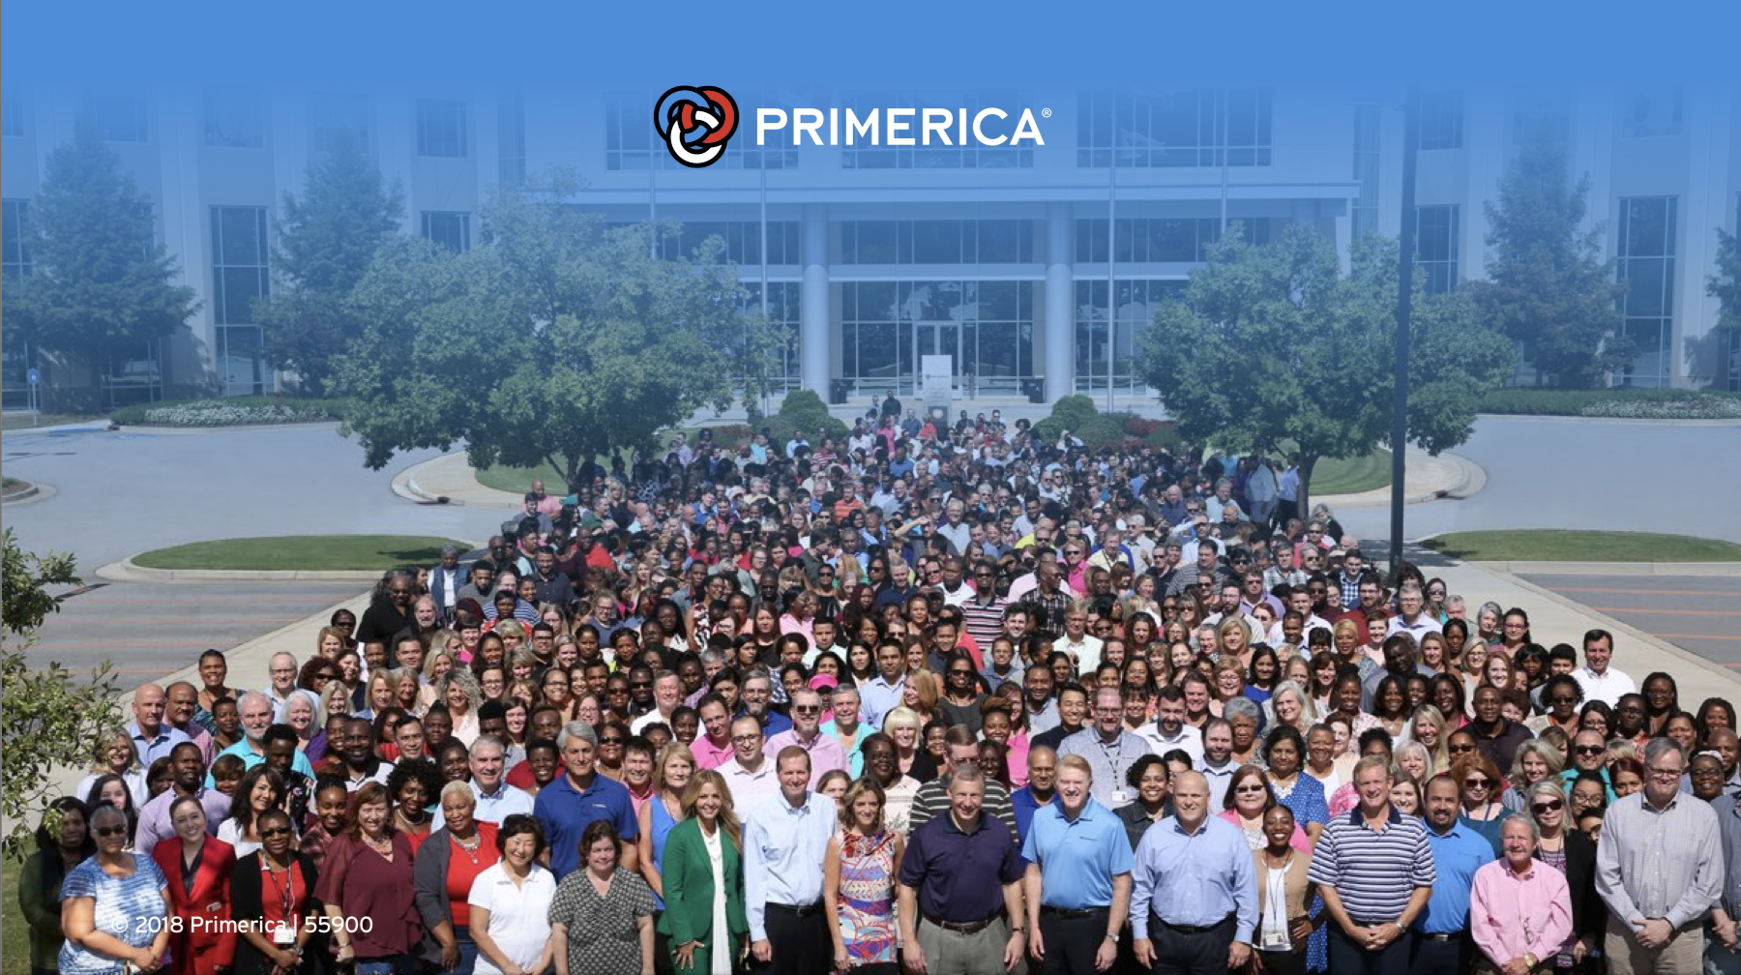
Primerica International Headquarters since 1977
Over 130,000 Licensed agents with more than 4,000 Locations
Serving over 7 Million Clients in the United States, Canada & Puerto Rico
More than 2,000 dedicated home office employees to support our clients and reps.

Slide 2


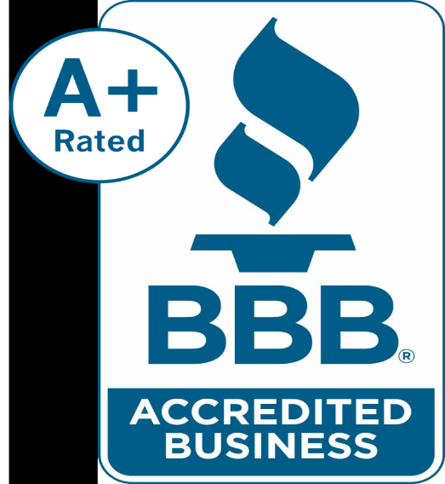
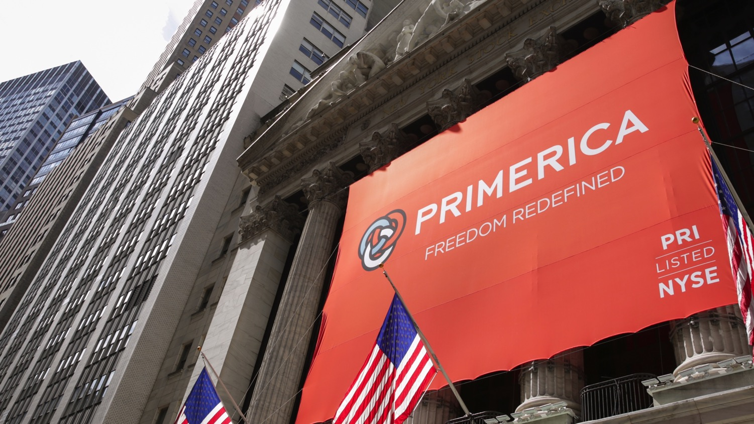
P
R
I
M
E
R
I
C
A

Slide 3















WORLD CLASS SUPPORT SYSTEM

Slide 4



Income Protection
HERE’S A REAL LIFE EXAMPLE:
$3,000
$3,000
Mortgage
Cars
Insurance
Credit Cards
Utilities
Groceries
Child Care
Internet / Cell / Cable
Etc.
$4,000
MONTHLY BILLS
MONTHLY INCOME
MONTHLY INCOME

Slide 5
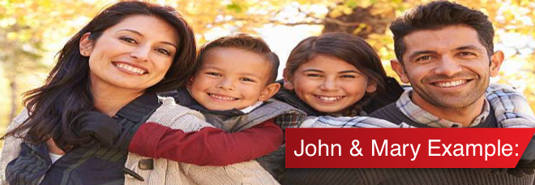

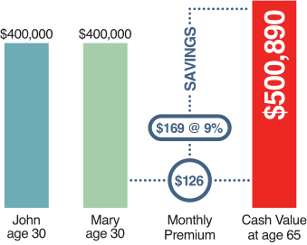
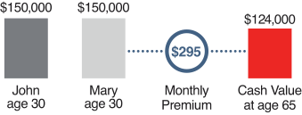
Our Crusade: Have The Right Protection
Cash Value Life Insurance
Whole Life,
Universal Life,
Variable Life
Index Universal Life
Return of Premium
Buy Term and Invest the Difference
35-year Level Term, $10,000 each on two children
Tax
Free
A or B

Slide 6


Slide 7
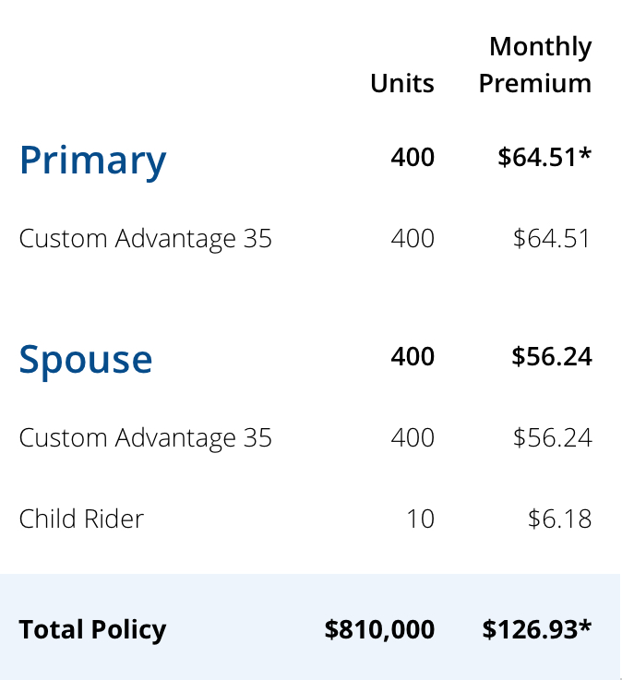
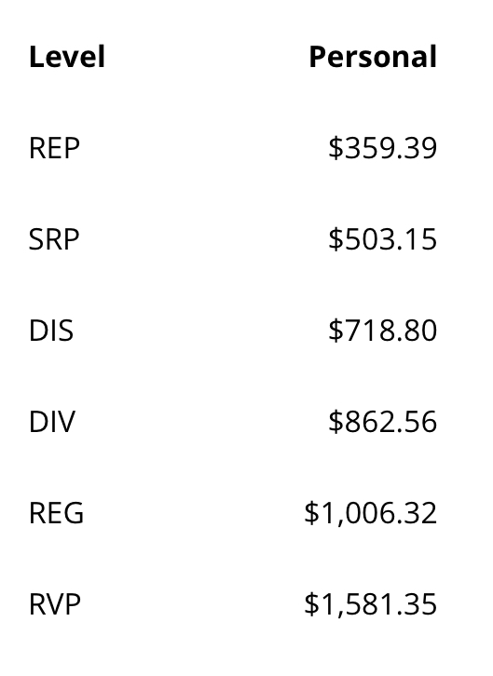


District Leader: Part-Time
Líder de Distrito: Tiempo Parcial
$863
Passive Income:
10 Clients = $8,630
Active Income:
4 Clients = $2,875

Slide 8

Good News & Bad News
License
TX
Good News
  Your Investment with the State:
  State Application
  Exam Fee
  Processing Fee
  Appointment Fee
  Fingerprint Fee
  Total Investment: $1,000
Pass Background Check & Qualify
Primerica will Sponsor all of your State Licensing Fees

Slide 9


Business Partnership
Independent Business Application (IBA)
$99
One Time
The Ultimate Business Support System (Optional)
$25
MONTH
  Your Investment with the State:
  Background check: $30
  State Class: $69
Technology Support Package Value Includes:
Cell phone discount: up to 25%/yr.
Your own website and business reports: $50/mo.
Live and on-demand video training: $55/mo.
Morningstar financial analysis software: $625/mo.
Errors & Omissions Insurance: $90/mo.
Total Value: $820+/month
  Our Investment with the State:
  State Application
  Exam Fee
  Processing Fees
  Appointment Fee
  Fingerprint Fee
  Total Value: $1,000

Slide 10
Similar Business Structure
Lost your #1 Agent
$0 Income on New Broker
Competitors

Slide 11
Profit Sharing Plan + Equity + Ownership
$10,000 in Shares
30%
$10,000 in Shares
+
$20,000 in Shares
$30,000 in Shares

Slide 12
